Slide 1
Digital Citizenship Parent Workshop Internet Safety

Slide 2
From Common Sense Media:
Teens are more likely to be targeted by online solicitors.
Online solicitations may come from someone they know.
Respect your “gut feeling” if something makes you feel uncomfortable.

Slide 3
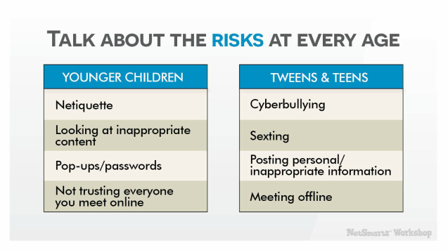
http://www.netsmartz.org/Presentations/Parents

Slide 4
If you are concerned…
http://www.netsmartz.org/Presentations/Parents

Slide 5
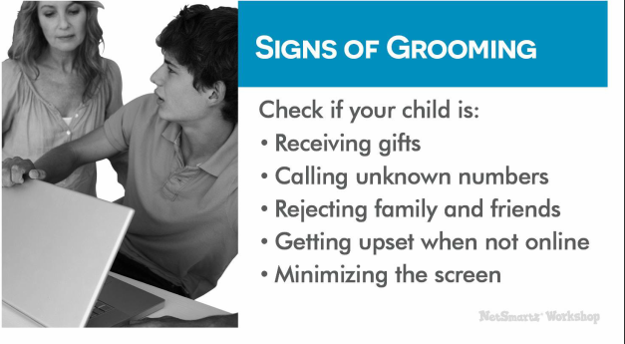
http://www.netsmartz.org/Presentations/Parents

Slide 6
Keeping our children safe online
On Websites:
Age appropriate language/activities
DON’T let young kids talk to people they don’t know
If they feel uncomfortable, TELL A TRUSTED ADULT!!
Bookmark sites for them to access

Slide 7
Red…risky
Yellow…iffy
Green…Okay
https://www.commonsensemedia.org/educators/digital-citizenship/internet-safety
https://commons.wikimedia.org/wiki/File:Traffic_lights_icon.svg

Slide 8
Keeping our kids safe online
On Social Media:
“Twitter doesn’t ask your age when you sign up, but Facebook does, and on Facebook the minimum age requirement is a hard and fast 13. It’s the same number on Instagram, Pinterest, Tumblr, Reddit, Snapchat and Secret, too.
http://www.adweek.com/digital/social-media-minimum-age/

Slide 9
Keeping our kids safe online:
On Social Media:
Check Terms of Agreement
Monitor accounts
“Friend” your children
If they feel uncomfortable, TELL A TRUSTED ADULT!!

Slide 10
Parents set an example…
http://www.netsmartz.org/Presentations/Parents

Slide 11
Keeping our kids safe online
On Websites DON’T share private information
Address
Telephone number
First name
Last name
Location information: school, name of the team you play for, name of park you visit, etc.

Slide 12
Online Friends vs. In Person Friends from Common Sense Media Curriculum: 3-5 Unit 3
Can’t tell if online friends are male or female
Can’t tell their age

Slide 13
Digital Citizenship Parent Workshop Internet Safety

Slide 14
Resources
Bennett, Shea, 2014. September 29. “Minimum Age Requirements: Twitter, Facebook, Instagram, Snapchat, WhatsApp, Secret.” Adweek. Retrieved from http://www.adweek.com/digital/social-media-minimum-age/
“Internet Safety” Common Sense Media: Digital Citizenship. Common Sense Media, 2017. Web. 21 June 2017.
"Internet Safety." NetSmartz Workshop. National Center for Missing & Exploited Children, 2015. Web. 30 June 2017.
www.netmartz.org
“Talking Safely Online (3-5).” Common Sense Media: Curriculum: Unit 3 Lesson 1. Common Sense Media. 2015. Web. 22 June 2017.

